Slide 1
Item List
Jungwon, Zahra, Kunwoo
Prof. Gunho Sohn's Lab
York University
May 10 2019

Slide 2
Item List (1/2) (May 10 2019)
Type | Item Name | Components | Delivery State | Testing State
Drone | DJI M600 Set | M600 body / Ronin-MX Gimbal / 2 RC / Batteries / RTK-GPS |  | Partially done
Drone | DJI M100 Set | M100 body / RC / Propellars / Batteries / A3 FC / Lightbridge |  | Partially done
Drone | DJI Mavic Air Set |  |  | Done
IMU | Spatial |  | Not delivered yet | Not done yet
UWB | TimeDomain | 5 UWB modules / 5 Batteries |  | Done
UWB | Pozyx |  | Not delivered yet | Not done yet
LiDAR | GeoSLAM | Scanner / Data logger / Dongle USB |  | Done
LiDAR | Velodyne Puck LITE |  |  | Not done yet
LiDAR | Velodyne Puck Hi-Res |  |  | Not done yet
LiDAR | Velodyne HDL-32E |  |  | Not done yet
Camera | Sony A7III |  | Not delivered yet | Not done yet
Camera | FLIR Duo R |  | Not delivered yet | Not done yet
Camera | ZED stereo |  | Not delivered yet | Not done yet
Camera | RealSense Depth |  |  | Not done yet
Computer | Intel NUC1 |  |  | Done
Computer | Intel NUC2 |  |  | Done
Computer | NVIDIA TX2 |  |  | Not done yet
Computer | Movidius

Slide 3
Item List (2/2) (May 10 2019)
Type | Item Name | Components | Delivery State | Testing State
Sub-device | Wifi router |  |  | Done
Sub-device | Laser distance |  |  | Done
Sub-device | Label maker |  |  | Done
 | Mini Prism |  |  | Done
Battery | Large1 |  |  | Done
Battery | Large2 |  |  | Done
Battery | Payload silver |  |  | Done
Solid | Tripod |  |  | Done
Solid | Chair |  |  | Done
Solid | Table |  |  | Done

Slide 4
DJI M600 Set

Slide 5
DJI M600 Set (1/)
To be added...

Slide 6
DJI M100 Set

Slide 7
DJI M100 Set (1/)
To be added...

Slide 8
DJI Mavic Air Set

Slide 9
DJI Mavic Air Set (1/)
To be added...

Slide 10
TimeDomain UWB P440

Slide 11
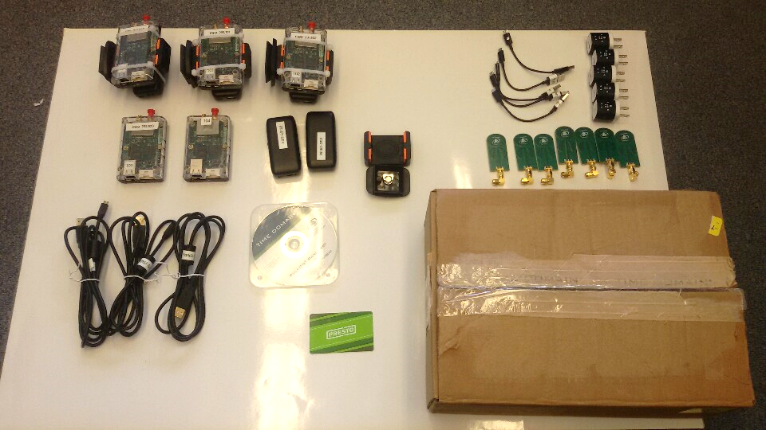
TimeDomain UWB P440 (1/)

Slide 12
GeoSLAM

Slide 13
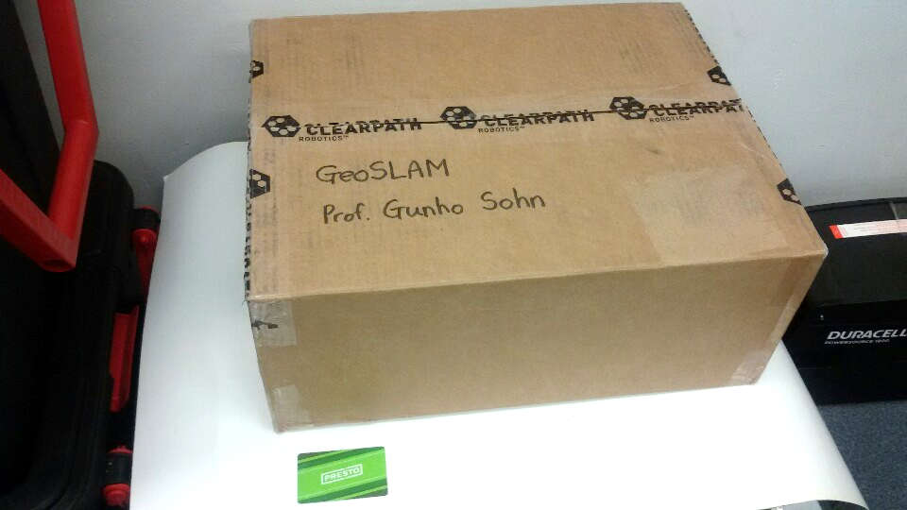
GeoSLAM (1/4)

Slide 14
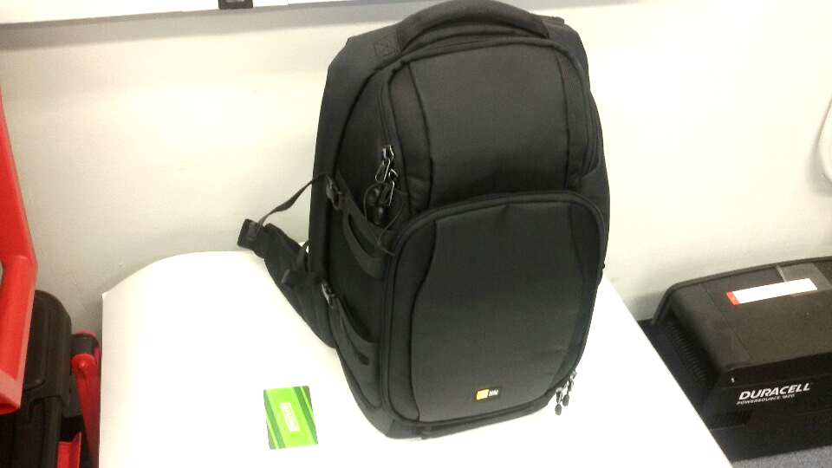
GeoSLAM (2/4)

Slide 15
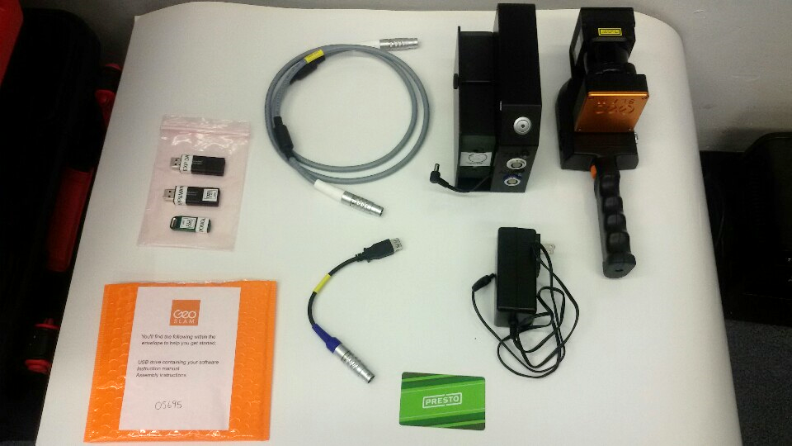
GeoSLAM (3/4)

Slide 16
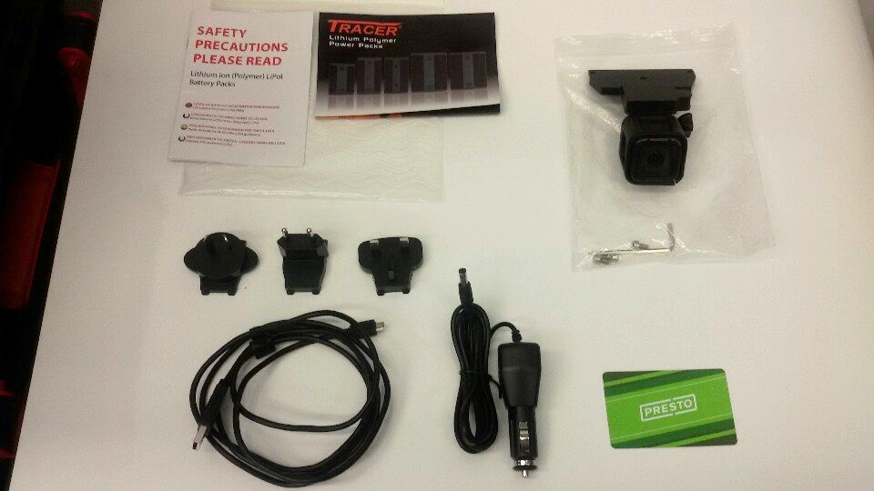
GeoSLAM (4/4)

Slide 17
Velodyne Puck LITE

Slide 18
Velodyne Puck LITE (1/)
To be added...

Slide 19
Velodyne Puck Hi-Res

Slide 20
Velodyne Puck Hi-Res (1/)
To be added...

Slide 21
Velodyne HDL-32E

Slide 22
Velodyne HDL-32E (1/)
To be added...

Slide 23
Intel RealSense D435
It was borrowed from Prof. Mozhdeh.

Slide 24
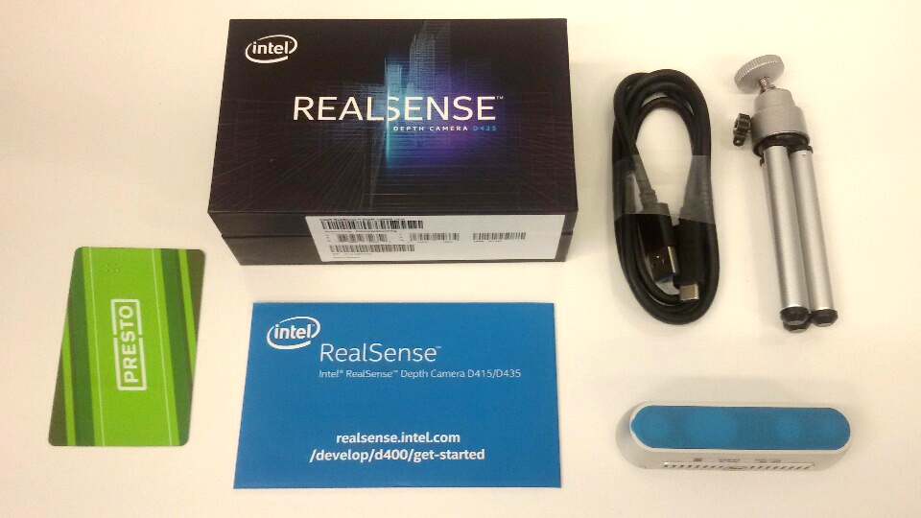
Intel RealSense D435 (1/1)

Slide 25
Intel NUC1

Slide 26
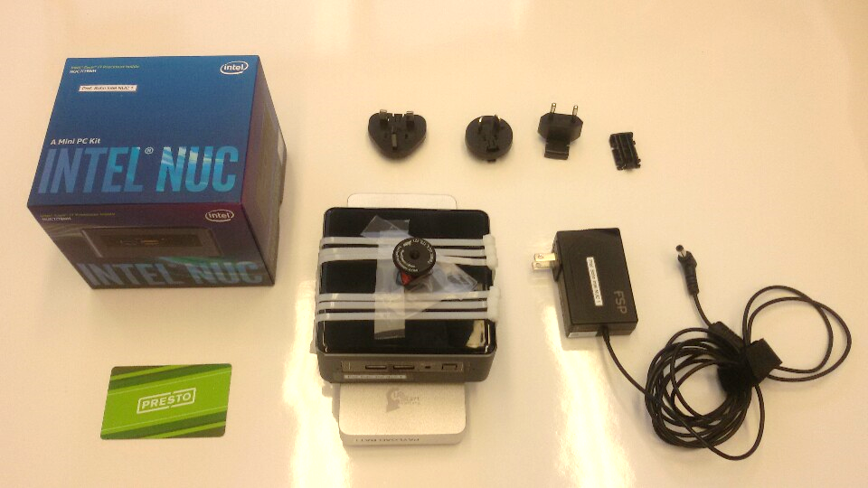
Intel NUC1 (1/)

Slide 27
Intel NUC2

Slide 28
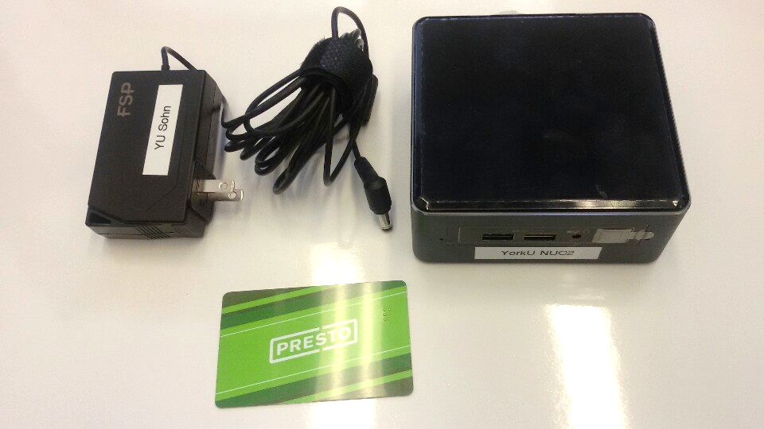
Intel NUC2 (1/1)

Slide 29
NVIDIA Jetson TX2

Slide 30
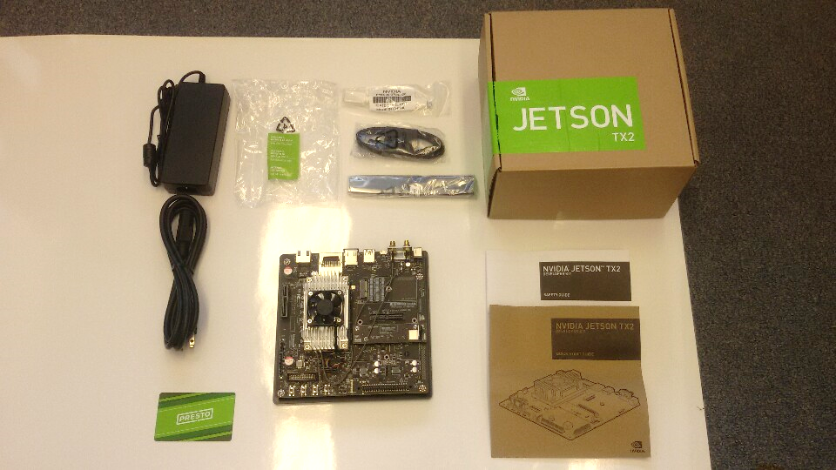
NVIDIA Jetson TX2 (1/1)

Slide 31
Movidius Neural Compute Stick

Slide 32
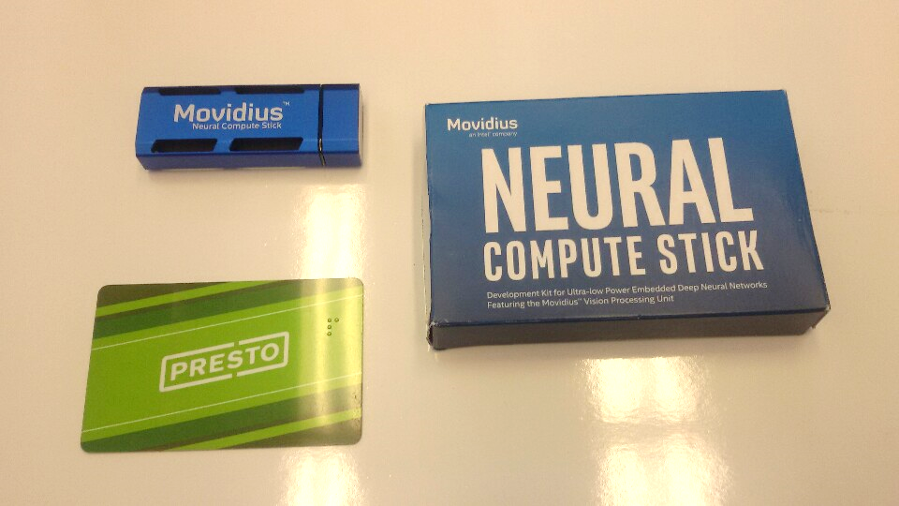
Movidius Neural Compute Stick (1/1)

Slide 33
Wifi Router

Slide 34
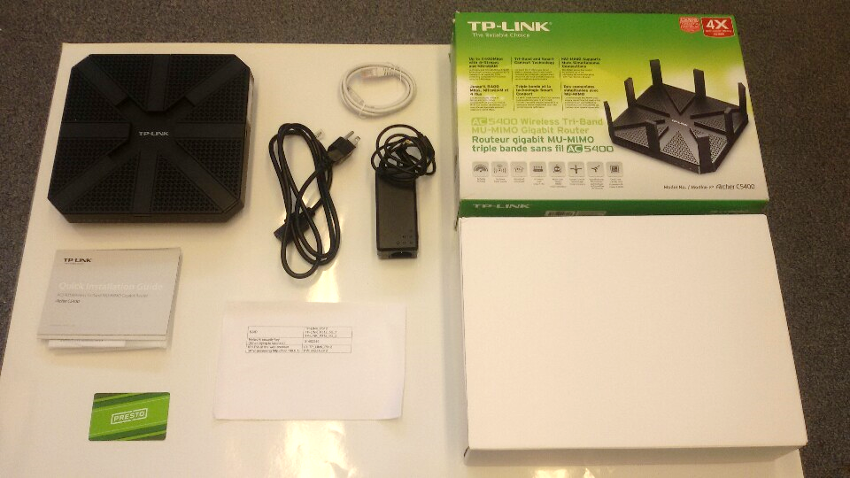
Wifi Router (1/)

Slide 35
Laser Distance Measurer

Slide 36
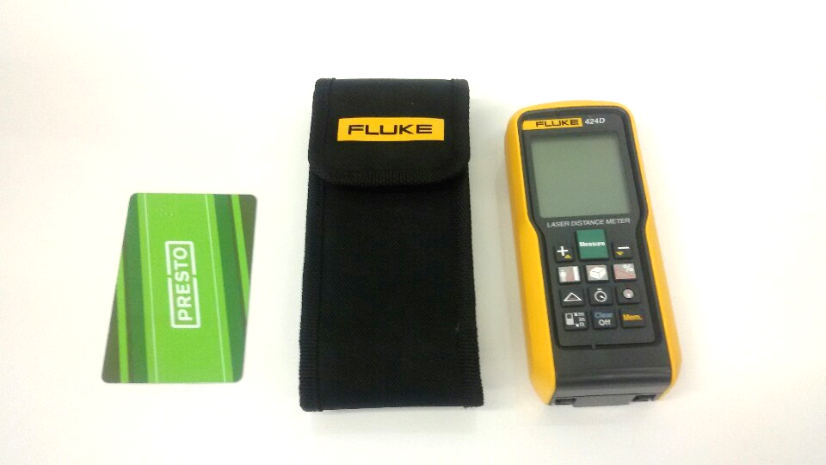
Laser Distance Measurer (1/1)

Slide 37
Label Maker

Slide 38
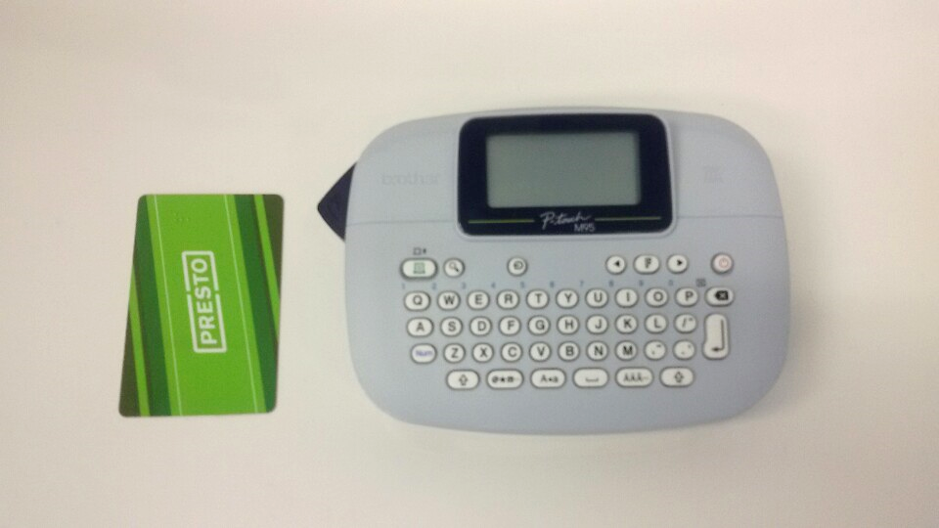
Label Maker (1/1)

Slide 39
Mini Prism

Slide 40
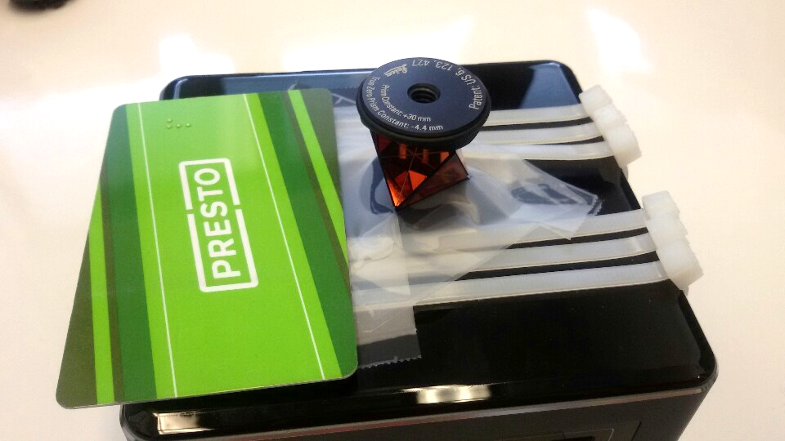
Mini Prism (1/)

Slide 41
Battery Large1

Slide 42
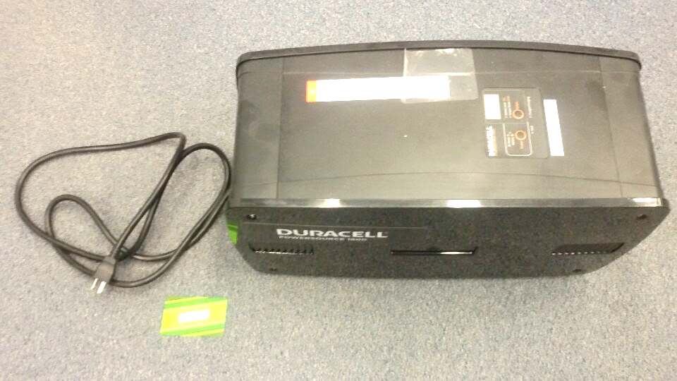
Battery Large1 (1/1)

Slide 43
Battery Large2

Slide 44
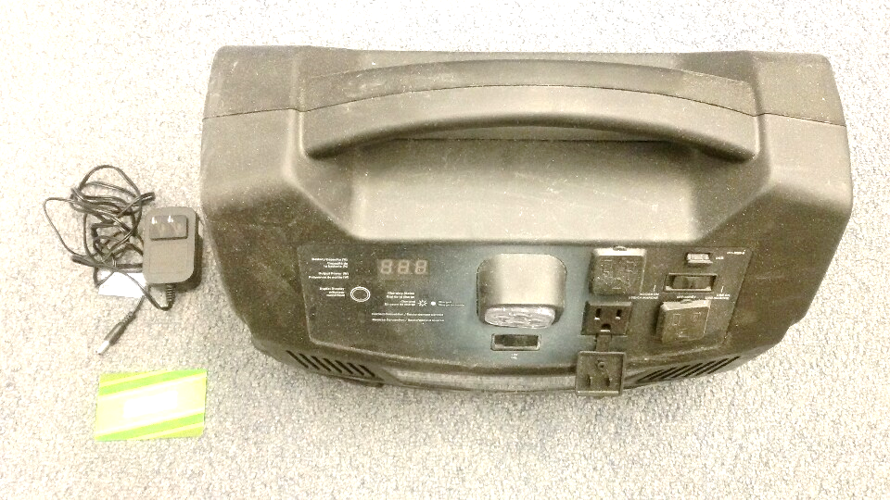
Battery Large2 (1/1)

Slide 45
Battery Payload Silver

Slide 46
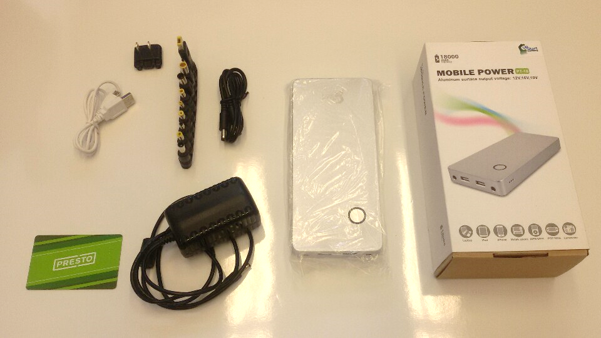
Battery Payload Silver (1/)

Slide 47
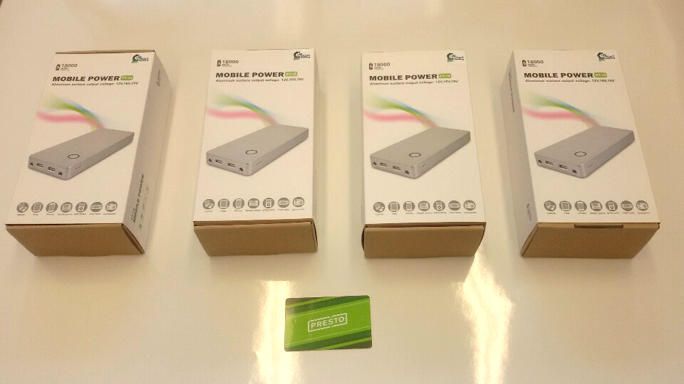
Battery Payload Silver (2/)

Slide 48
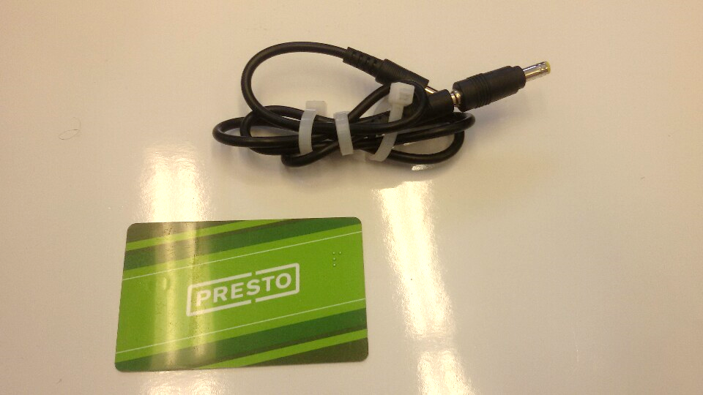
Battery Payload Silver (3/)

Slide 49
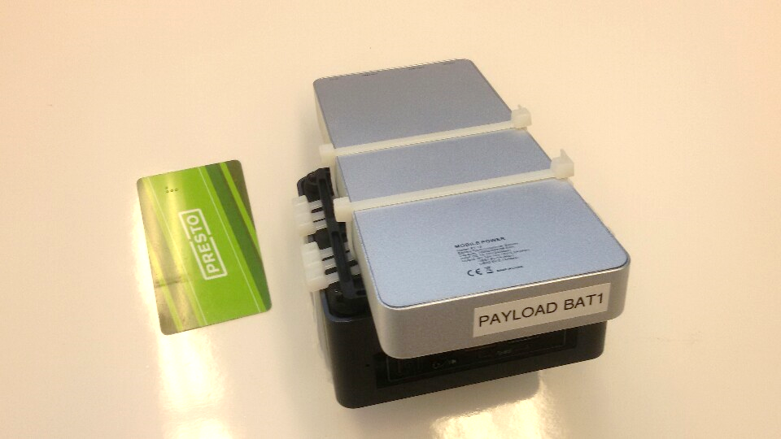
Battery Payload Silver (4/)

Slide 50
Tripod

Slide 51
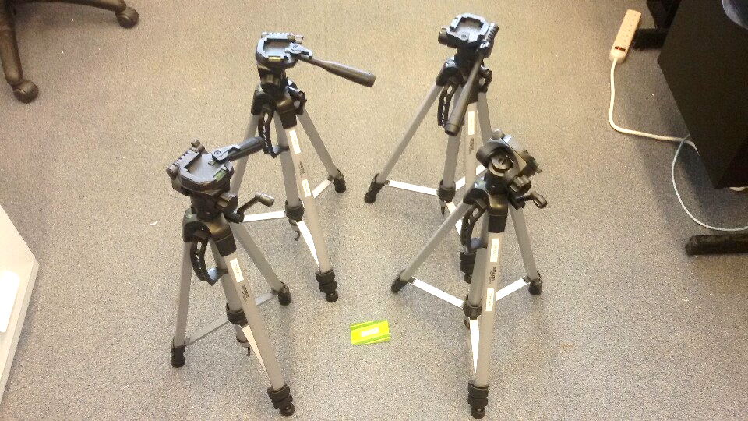
Triopod (1/)

Slide 52
Chairs

Slide 53
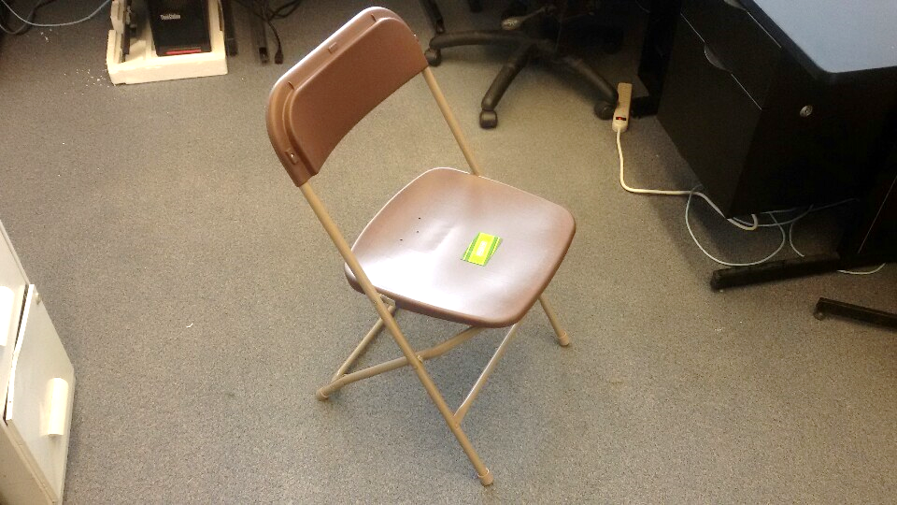
Chairs (1/)

Slide 54
Table

Slide 55
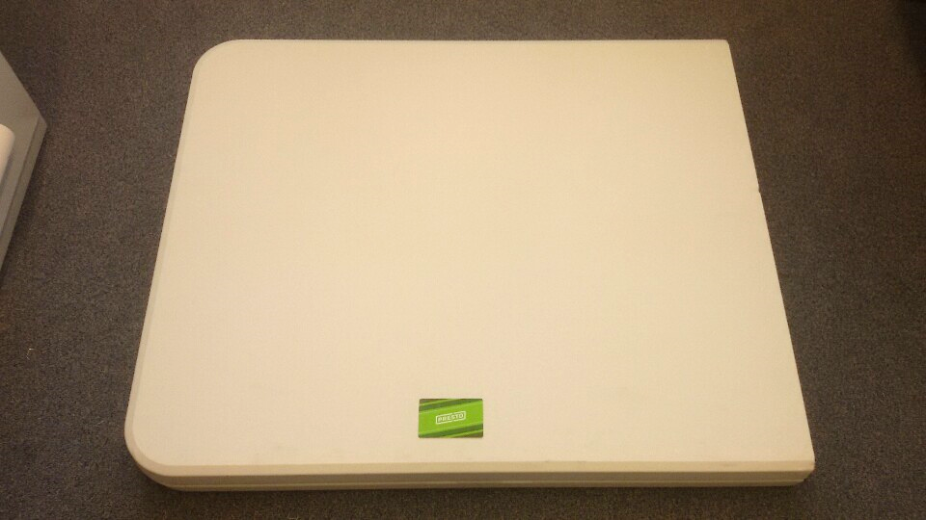
Table (1/)

